Slide 1
Operating Systems
Computer Architecture Support to Operating System

Slide 2
What is an Operating System?
A program that acts as an intermediary between a user of a computer and the computer hardware
Operating system goals:
  Execute user programs and make solving user problems easier
  Make the computer system convenient to use
  Use the computer hardware in an efficient manner

Slide 3
Computer System Structure
Computer system can be divided into four components:
  Hardware – provides basic computing resources
    CPU, memory, I/O devices
  Operating system
    Controls and coordinates use of hardware among various applications and users
  Application programs – define the ways in which the system resources are used to solve the computing problems of the users
    Word processors, compilers, web browsers, database systems, video games
  Users
    People, machines, other computers

Slide 4

Four Components of a Computer System

Slide 5
What Operating Systems Do
The operating system controls the hardware and coordinates its use among the various application programs for the various users.
We can also view a computer system as consisting of hardware, software, and data.
The operating system provides the means for proper use of these resources in the operation of the computer system.
An operating system is similar to a government. Like a government, it performs no useful function by itself. It simply provides an environment within which other programs can do useful work.
To understand more fully the operating system's role, we explore operating systems from two viewpoints:
  The user
  The system.

Slide 6
User View
The user's view of the computer varies according to the interface being used
Single user computers (e.g., PC, workstations). Such systems are designed for one user to monopolize its resources. The goal is to maximize the work (or play) that the user is performing. the operating system is designed mostly for ease of use and good performance.
Multi user computers (e.g., mainframes, computing servers). These users share resources and may exchange information. The operating system in such cases is designed to maximize resource utilization -- to assure that all available CPU time, memory, and I/O are used efficiently and that no individual users takes more than their air share.

Slide 7
User View (Cont.)
Handheld computers (e.g., smartphones and tablets). The user interface for mobile computers generally features a touch screen. The systems are resource poor, optimized for usability and battery life.
Embedded computers (e.g., computers in home devices and automobiles) The user interface may have numeric keypads and may turn indicator lights on or off to show status. The operating systems are designed primarily to run without user intervention.

Slide 8
System View
From the computer's point of view, the operating system is the program most intimately involved with the hardware. There are two different views:
The operating system is a resource allocator
  Manages all resources
  Decides between conflicting requests for efficient and fair resource use
The operating systems is a control program
  Controls execution of programs to prevent errors and improper use of the computer

Slide 9
Defining Operating System
No universally accepted definition of what an OS:
Operating systems exist to offer a reasonable way to solve the problem of creating a usable computing system.
The fundamental goal of computer systems is to execute user programs and to make solving user problems easier.
Since bare hardware alone is not particularly easy to use, application programs are developed.
  These programs require certain common operations, such as those controlling the I/O devices.
  The common functions of controlling and allocating resources are brought together into one piece of software: the operating system.

Slide 10
Defining Operating System (Cont.)
No universally accepted definition of what is part of the OS:
A simple viewpoint is that it includes everything a vendor ships when you order the operating system. The features that are included vary greatly across systems:
  Some systems take up less than a megabyte of space and lack even a full-screen editor,
  Some systems require gigabytes of space and are based entirely on graphical windowing systems.

Slide 11
Defining Operating System (Cont.)
No universally accepted definition of what is part of the OS:
A more common definition, and the one that we usually follow, is that the operating system is the one program running at all times on the computer -- usually called the kernel.
Along with the kernel, there are two other types of programs:
  System programs, which are associated with the operating system but are not necessarily part of the kernel.
  Application programs, which include all programs not associated with the operation of the system.

Slide 12
Defining Operating System (Cont.)
The emergence of mobile devices, have resulted in an increase in the number of features that constituting the operating system.
Mobile operating systems often include not only a core kernel but also middleware -- a set of software frameworks that provide additional services to application developers.
For example, each of the two most prominent mobile operating systems -- Apple's iOS and Google's Android -- feature a core kernel along with middleware that supports databases, multimedia, and graphics (to name only a few).

Slide 13
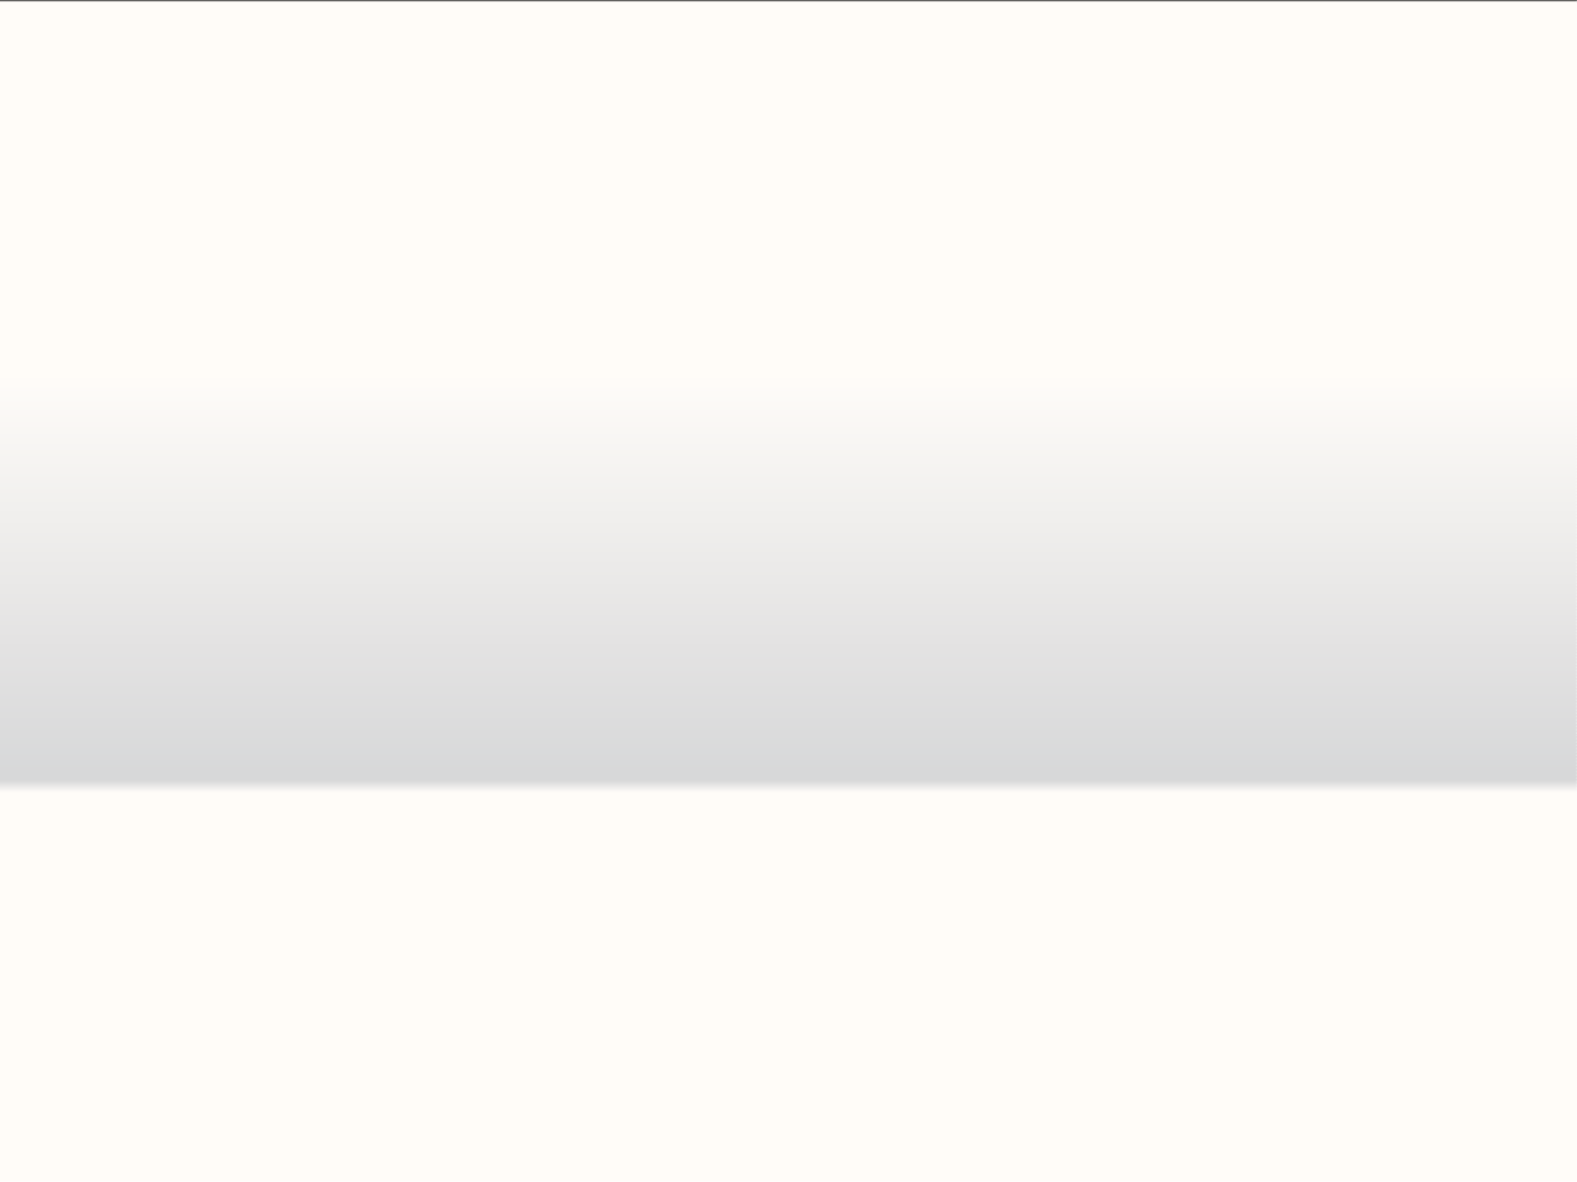
















Simple Batch System
Multi-programming System
Real time Operating System
Multi-processing System
Distributed Operating System

Slide 14
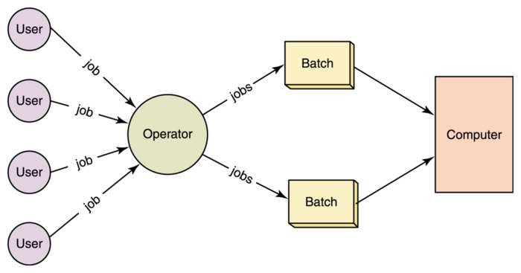
SIMPLE BATCH SYSTEM
In Batch processing same type of jobs batch (BATCH- a set of jobs with similar needs) together and execute at a time.
The OS was always resident in memory.

Slide 15
ADVANTAGES
A data center’s staff can schedule batch processing during times when the computers are otherwise idle, such as overnight.
The computer operators can delay or prioritize different batches easily, depending on circumstances.
DISADVANTAGES
Zero interaction between user and computer.
No mechanism to prioritize processes.
CPU is often idle, because the speeds of the mechanical I/O devices is slower than CPU.
Examples
Payroll run for company.
Gas and electricity bills produced by batch system.

Slide 16
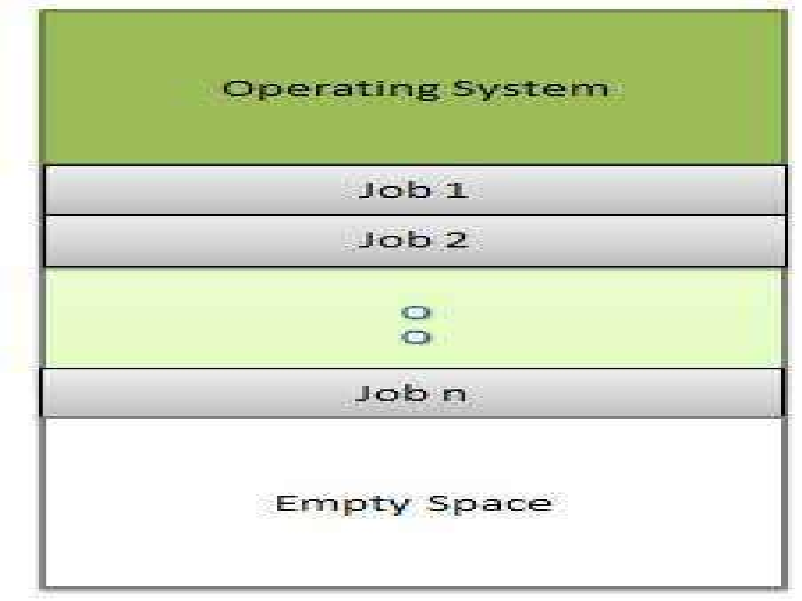
MULTI-PROGRAMMING SYSTEM
In this the operating system, picks and begins to execute one job from memory.
Multiprogramming system, CPU will never be idle and keeps on processing.
ADVANTAGES
It increases CPU utilization.
It maximizes the total job throughput of a computer.
Better Reliability-if one processor breakdown then other takes its workload.
Example
Consider that Three jobs are submitted. Almost no contention for resources . All three can run in minimum time in a multitasking environment (assuming JOB2/3 have enough CPU time to keep their I/O operations active)
DISADVANTAGES
It must keep track of all kinds of jobs.
Each system requires large chunks of hard drive space which cannot be allocated to programs.
Poor CPU usage when only one program is present in memory.

Slide 17
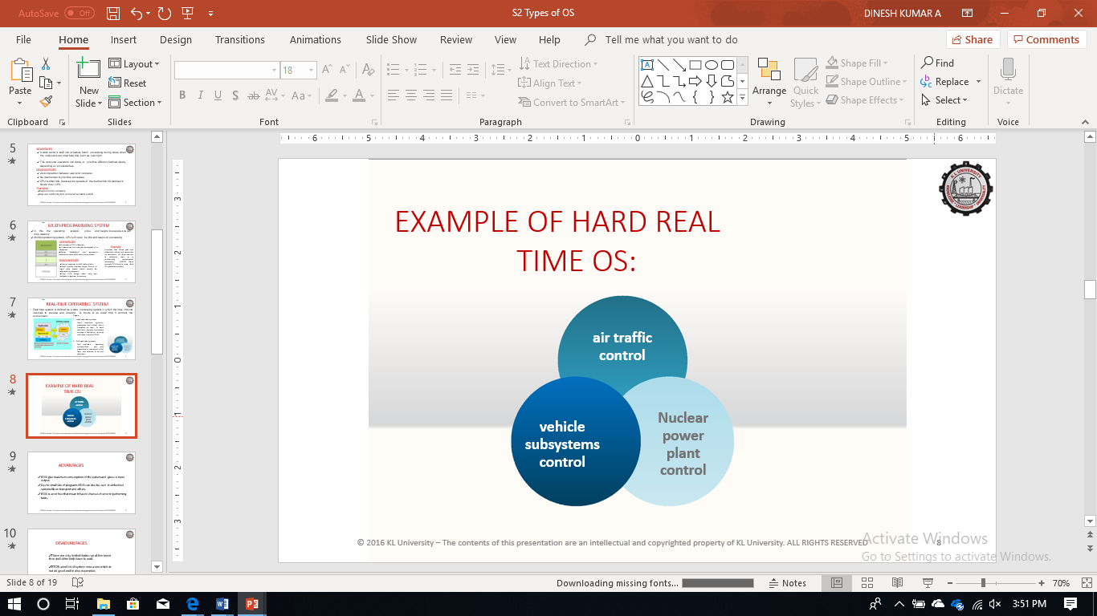
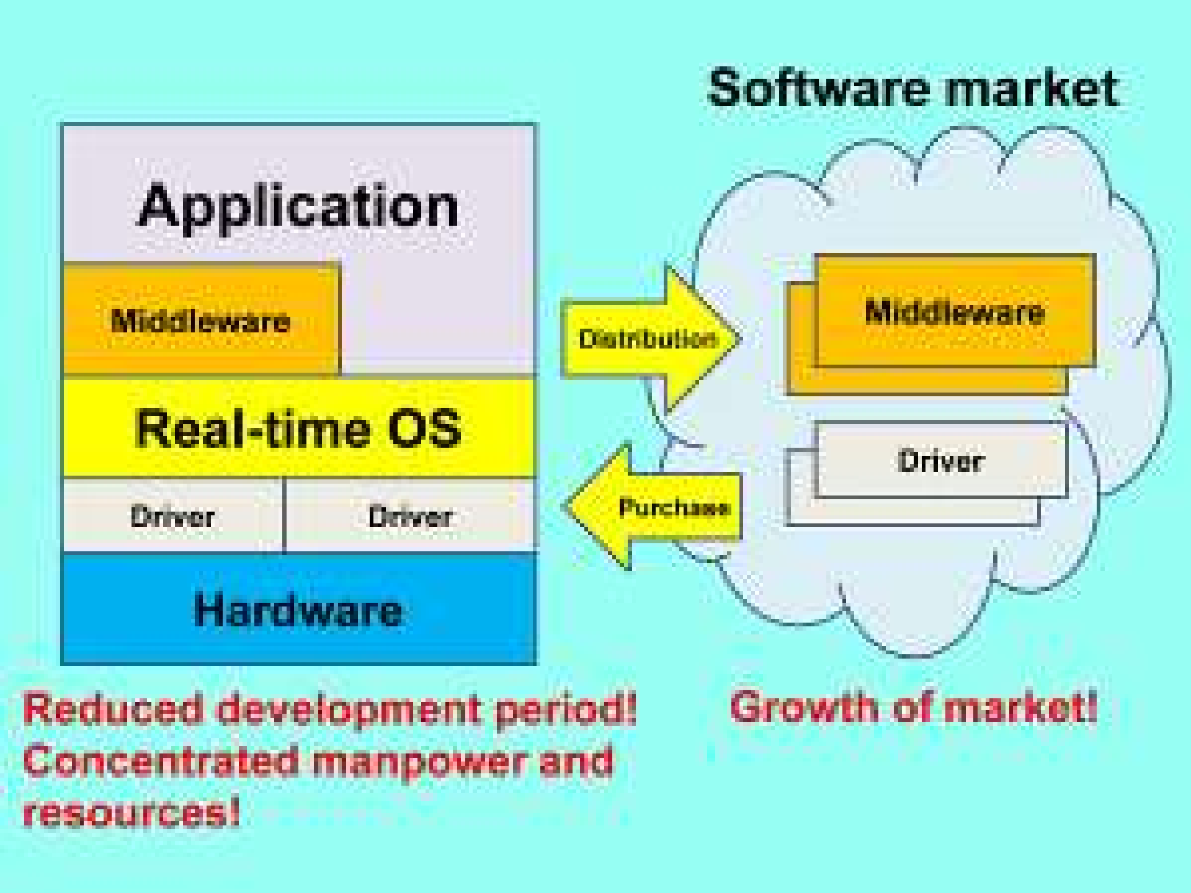
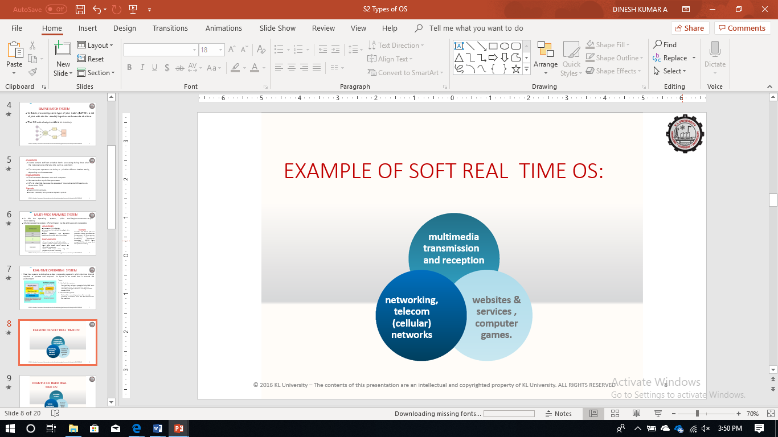
REAL-TIME OPERATING SYSTEM
Real time system is defined as a data processing system in which the time interval required to process and respond to inputs is so small that it controls the environment.
Types:
Hard real-time systems
  Hard real-time systems- guarantee that critical tasks complete on time. In hard real-time systems secondary storage is limited or missing with data stored in ROM
Soft real-time systems
  Soft real-time operating systems-that can only guarantee a maximum of the time are referred to as soft real-time.

Slide 18
ADVANTAGES
RTOS give maximum consumption of the system and gives us more output.
Due to small size of programs RTOS can also be used in embedded systems like in transport and others.
RTOS is error free that mean it has no chances of error in performing tasks.
DISADVANTAGES
There are only limited tasks run at the same time and other task have to wait.
RTOS used lot of system resources which is not as good and is also expensive.
Multi tasking is done few of times and this is the main disadvantage of RTOS.

Slide 19
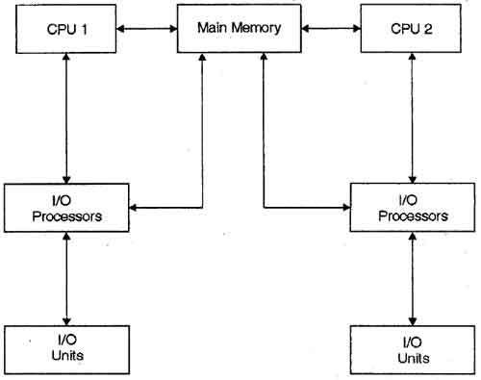
MULTIPROCESSOR SYSTEM
A multiprocessor system consists of several processors that share a common physical memory. Multiprocessor system provides higher computing power and speed.
ADVANTAGES
DISADVANTAGES
Enhanced performance.
Execution of several tasks by different processors concurrently, increases the system's throughput.
It's more complex than other operating systems.
It requires context switching which slightly impacts performance.

Slide 20
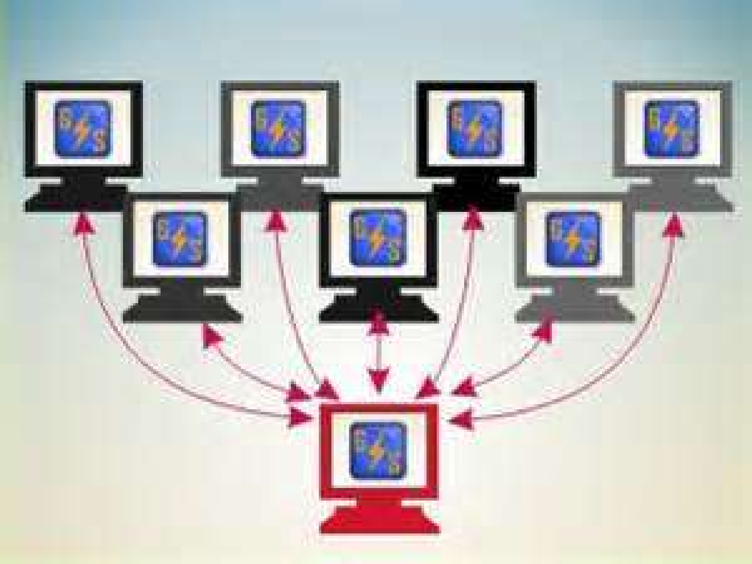
DISTRIBUTED OPERATING SYSTEM
The motivation behind developing distributed operating systems is the availability of powerful and inexpensive microprocessors and advances in communication technology.
ADVANDAGES
If one machine crashes, the system as a whole can still survive.
A distributed system may have more total computing power than a mainframe.
Since it is an open system it is always ready to communicate with
other systems.
DISADVANDAGES
Distributed systems will have an inherent security issue.
If the network gets saturated then problems with transmission will surface.
There is currently very little less software support for Distributed system.

